Slide 1

My application is fully concurrent and async.
What about the database?
Davide Mauri
Product Manager
Microsoft
Level: Beginner to Intermediate

Slide 2

Davide Mauri
Joined Azure SQL group on mid 2019
SQL Server / Azure Data MVP for 12 Years
Worked in consulting services for 20 years
Still a developer at heart!
Now Azure SQL PM
Focus on Azure SQL & Developers
Very active in the Community, Conference Speaker
Website: http://davidemauri.it/
DevBlogs: https://devblogs.microsoft.com/azure-sql/
Twitter: @mauridb

Slide 3
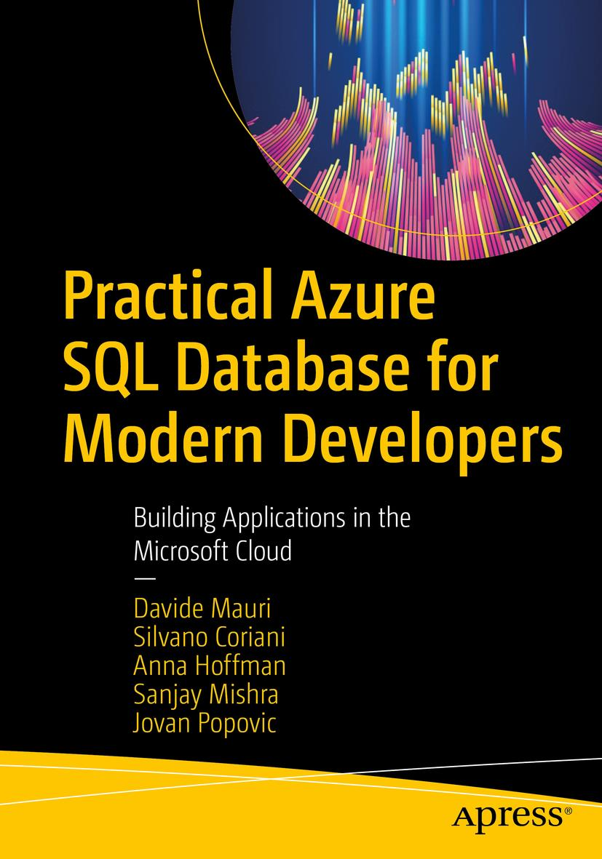
A Database book for Developers
A developer-focused book, to help you leverage all the relational and post-relational features that Azure SQL has, to easily create fast, scalable and secure applications
Lots of samples and discussions taking into account different languages:
Python
.NET
Java
And more!

Slide 4

Session Survey
Your feedback is very important to us
Please take a moment to complete the session survey found in the mobile app
Use the QR code or search for “Converge360 Events” in your app store
Find this session on the Agenda tab
Click “Session Evaluation”
Thank you!

Slide 5
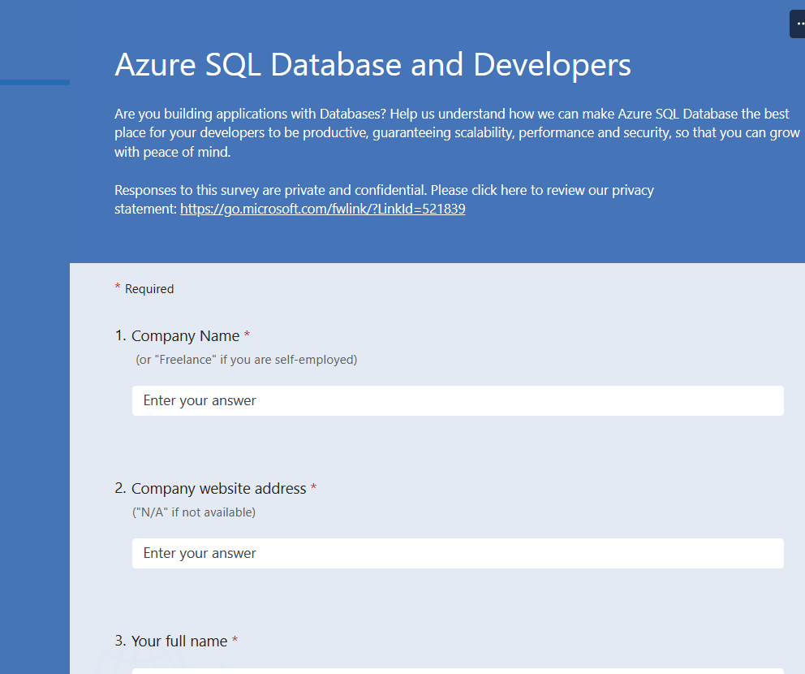
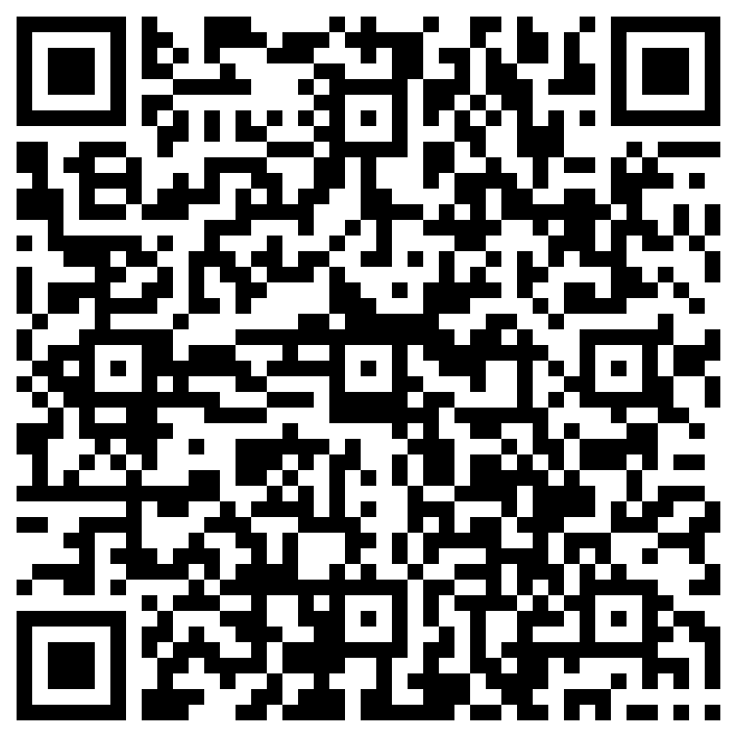
Tell us what you want from Azure SQL
https://aka.ms/datadevlist

Slide 6

Agenda
Opening a connection: what happen behind the scenes
Transactions, Auto-Commit and Explicit Transactions
Locking and Versioning
Isolation Levels
In-Memory Lock-Free Tables
Tips and Tricks
Notes:
Locks vs Row versioning
Isolation levels
Implicit/Explicit Transactions
Using JSON + Stored Procedures to keep transaction super short
UPSERT / SELECT for UPDATE
Bulk Updates

Slide 7
DEMO
A first peek under the hood
Notes:
Just connect to the database and see what’s going on. Introduce S locks and locked objects
Demo1 in sample App + Monitoring Script

Slide 8
Locks
Different type of lock modes.
The two basic lock modes:
S - Shared
X - Exclusive
Just like people, a lock can be compatible with another, or not ☺
X: doesn’t really go well with anyone
S: let’s party together!

Slide 9
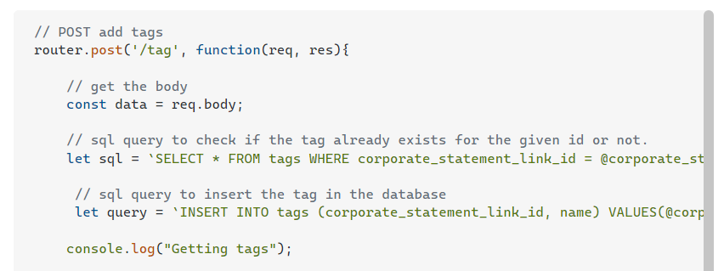
A common problem…
At the same time someone else executes the same request

Slide 10
Transactions and Errors
Transactions: ACID.
Atomicity, Consistency, Isolation, Durability
Atomicity => All or Nothing
“Autocommit” transactions: Every Transact-SQL statement is committed or rolled back when it completes. If a statement completes successfully, it is committed; if it encounters any error, it is rolled back.

Slide 11
Transactions and Errors
“Explicit” Transactions
Start with: BEGIN TRAN
All commands in a transaction will be executed as if they were logically a single command (so: all or nothing!)
End with: COMMIT/ROLLBACK TRAN

Slide 12
Transactions and Errors
By default, with explicit transactions, is a developer responsibility to decide if an error requires a rollback or not
Errors in Stored Procedures and even withing explicit transactions *will not* be automatically rolled back
Trap exceptions and decide if you can still commit the transaction or you really need to rollback
For example: if the error is transient, like a deadlock.
Rollback is really the most common use case so, there is an option for that ☺
Pay attention if your driver (JDBC?) is using IMPLICT TRANSACTIONS!

Slide 13
Demo
Transaction Management
Notes:
“Transaction Basics” and “Transaction & Errors” Demos

Slide 14
What was learned?
From the *SAME* connection (and thus the same transaction) you can always access the data you have changed.
If you are using a multi-threaded application, each thread is using a connection,
Transactions must (and will) be ISOLATED!
No, you probably don’t want two different threads operating in the same transaction.

Slide 15
How Transactions and Locks related?
Locks are used to guarantee isolation and avoid inconsistencies
The only way to avoid potential inconsistencies in a concurrent system is to serialize all data access. That is not good for concurrency, though….
The ISOLATION LEVEL defines what kind of isolation we want to get
To avoid inconsistencies and anomalies (Lost Updates, Dirty Reads, Inconsistent Analysis, Phantom Reads)
Based on the ISOLATION LEVEL the appropriate locks are taken
Also based on resources usage
The SQL engine tries to balance between resource usage and concurrency
Notes:
Just connect to the database and see what’s going on. Introduce S locks and locked objects
Demo2 in sample App + Monitoring Script

Slide 16
Isolation Levels
READ UNCOMMITTED
READ COMMITTED (default in SQL Server)
Can also be READ COMMITTED SNAPSHOT (default in Azure SQL), to use versioning
REPEATABLE READ
SERIALIZABLE
Can also be SNAPSHOT, to use versioning

Slide 17
DEMO
What happen when my app executes a query?
Notes:
Show what happens with the default isolation level. Demo2 in sample App + Monitoring Script
Show what happens with the REPEATABLE READ isolation level. Demo3 in sample App + Monitoring Script

Slide 18
What was learned?
The longer the transaction, the longer the locks are held
even if the SQL engine tries to minimize as much as possible that lifespan of a lock!
But that depends on the ISOLATION LEVEL
So: the shorter the transaction the better!
The shortest transition possible is the one that is started end finished directly on the engine (and not by an external application)
So, use a batch or a stored procedure if you can

Slide 19
Locks
Many different types of objects can be locked. Here’s some:
DATABASE
PAGE
KEY
RID
METADATA

Slide 20
Locks and Row Versions
On Azure SQL DB, the default transaction isolation level is READ COMMITED SNAPSHOT
Uses Row Versioning instead of locking to preserve transaction isolation and consistency
You can read all *committed* data
Reads will not be blocked by writes
Please do not use NOLOCK anymore. In Azure SQL you are just faster!
Hint: Use READ COMMITED SNAPSHOT in SQL Server too

Slide 21
In-Memory Lock-Free Tables
If you need extreme performances and concurrency you can use “MEMORY OPTIMIZED” tables
Like 5M transactions/sec?
Look like a table, but more an in-memory concurrency optimized data structures
No locks or other synchronization mechanism
Uses row versioning and some advanced low-level operations like “compare-and-swap”
Indexing on Modern Hardware: Hekaton and Beyond
Building a Bw-Tree Takes More Than Just Buzz Words

Slide 22
Tips and Tricks
Use JSON or TVPs to move data to the database and then do the transaction there
Yep, Stored Procedures ☺
The go with OPENJSON / FOR JSON and be happy! ☺
If you’re using an ORM, make sure you batch the requests
EF Core do it for you already! (And can also use JSON too)
It can be tweaked and configured, if needed

Slide 23
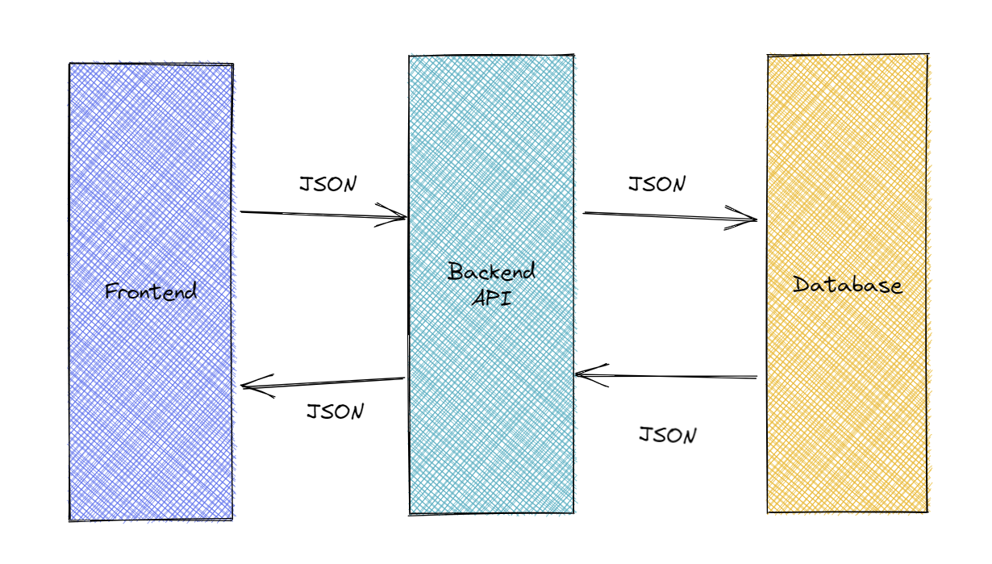
This is great!
https://github.com/azure-samples/azure-sql-db-dotnet-rest-api

Slide 24
Insert if not exists
UPLOCK is handy: “read with the intent of updating”
Read more here: The “insert if not exists” challenge: a solution

Slide 25
Latest Optimization
SQL Engine is *always* improving
Optimized Locking
Lock-after-qualification
Transaction ID Locking
Currently, optimized locking is available in Azure SQL Database only

Slide 26
What if you need to load data into the database, *fast*
Use BULK LOAD APIs
BULK INSERT in T-SQL
SqlBulkCopy in .NET
Bulk load uses a special lock: BU
A BU lock is compatible with another BU lock
When loading a table, you can do it in parallel if correct conditions exists
For example table is an HEAP or is PARTITIONED
Fast Data Loading in Azure SQL DB using Azure Databricks

Slide 27
Resources
Transaction locking and row versioning guide
Thread and Task Architecture Guide
In-Memory OLTP overview and usage scenarios
sp_whoisactive

Slide 28
Tell us what *you* want from MSSQL
https://aka.ms/datadevlist

Slide 29

Questions?

Slide 30

There is so much to learn!
Demos
TBD
Curated list of links, samples, videos, etc
https://github.com/yorek/awesome-azure-sql
Samples on specific features
https://github.com/yorek/azure-sql-db-samples

Slide 31
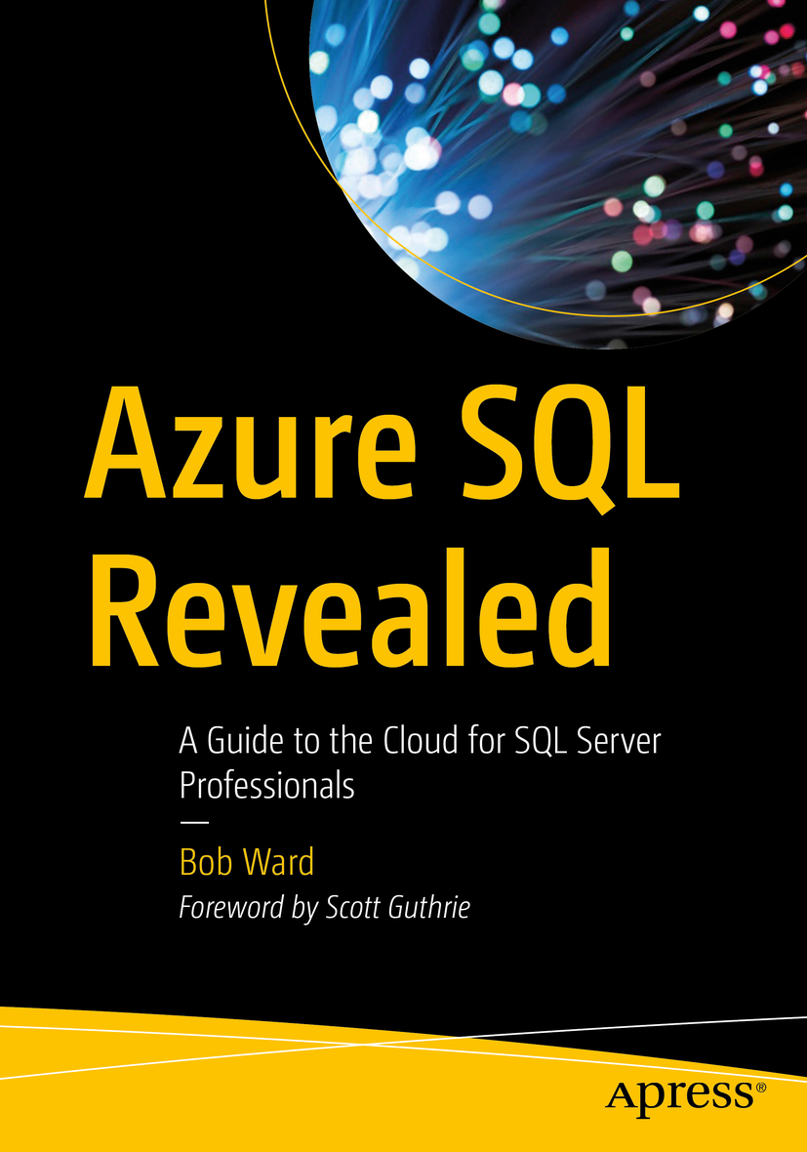



Resources
https://aka.ms/bobwardms
https://aka.ms/bobsqldemos
https://aka.ms/awesome-sql
Microsoft Learn: Azure SQL fundamentals learning path
aka.ms/azuresqlfundamentals
Azure SQL documentation
aka.ms/azuresqldocs
More videos from our team
aka.ms/azuresqlyt
Azure SQL Database tips
aka.ms/sqldbtips
Choose your SQL driver
aka.ms/sqldrivers
Get Azure for free
aka.ms/getfreeazuresql
aka.ms/azuresqlbook
aka.ms/azuresqlfordevelopers
Notes:
Bob

Slide 32
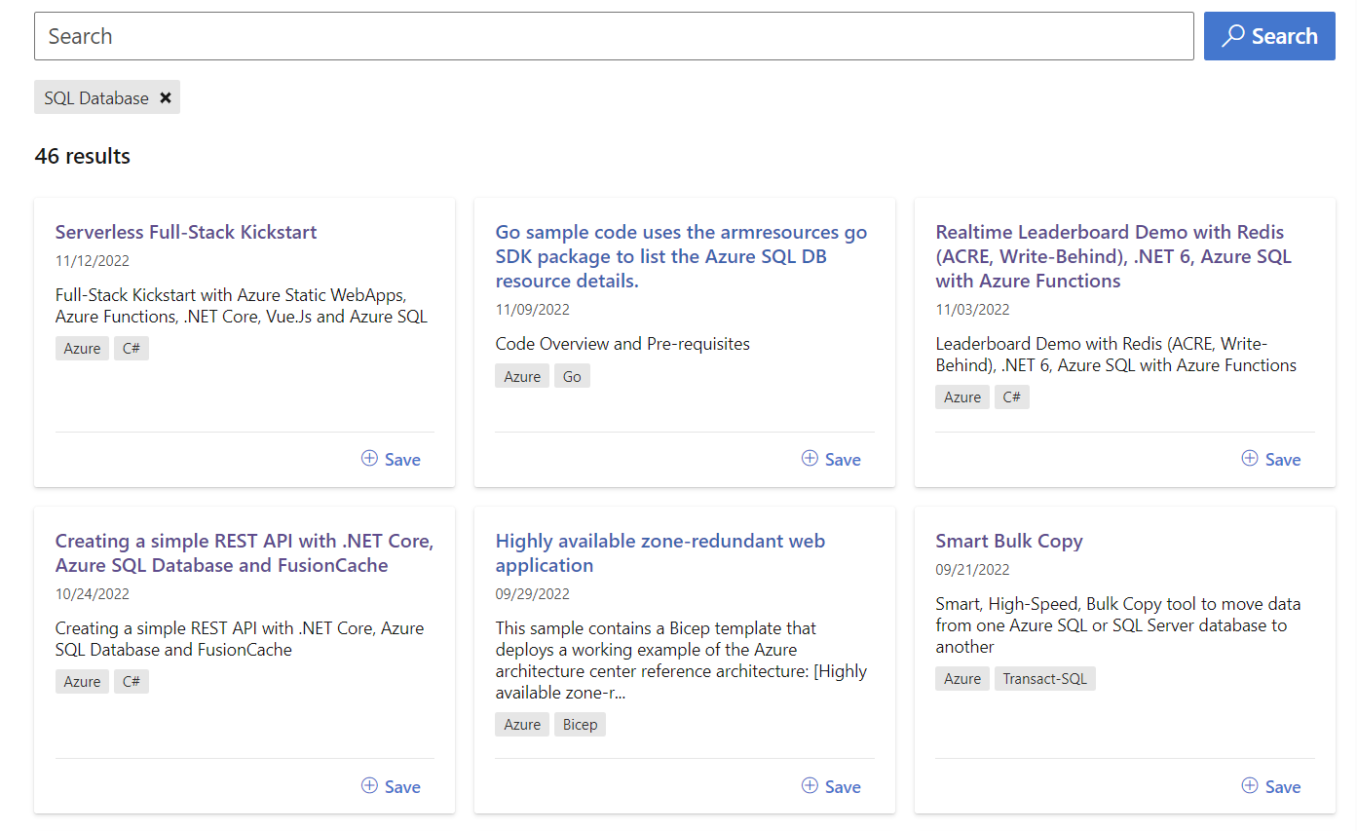
Microsoft Learn Samples
https://learn.microsoft.com/en-us/samples/browse/?expanded=azure&products=azure-sql-database

Slide 33

Thanks!
Davide Mauri
damauri@microsoft.com

